Slide 1
Eli Chandler Sprint 003
May 10 – 24
Work hard rating 3/5

Slide 2
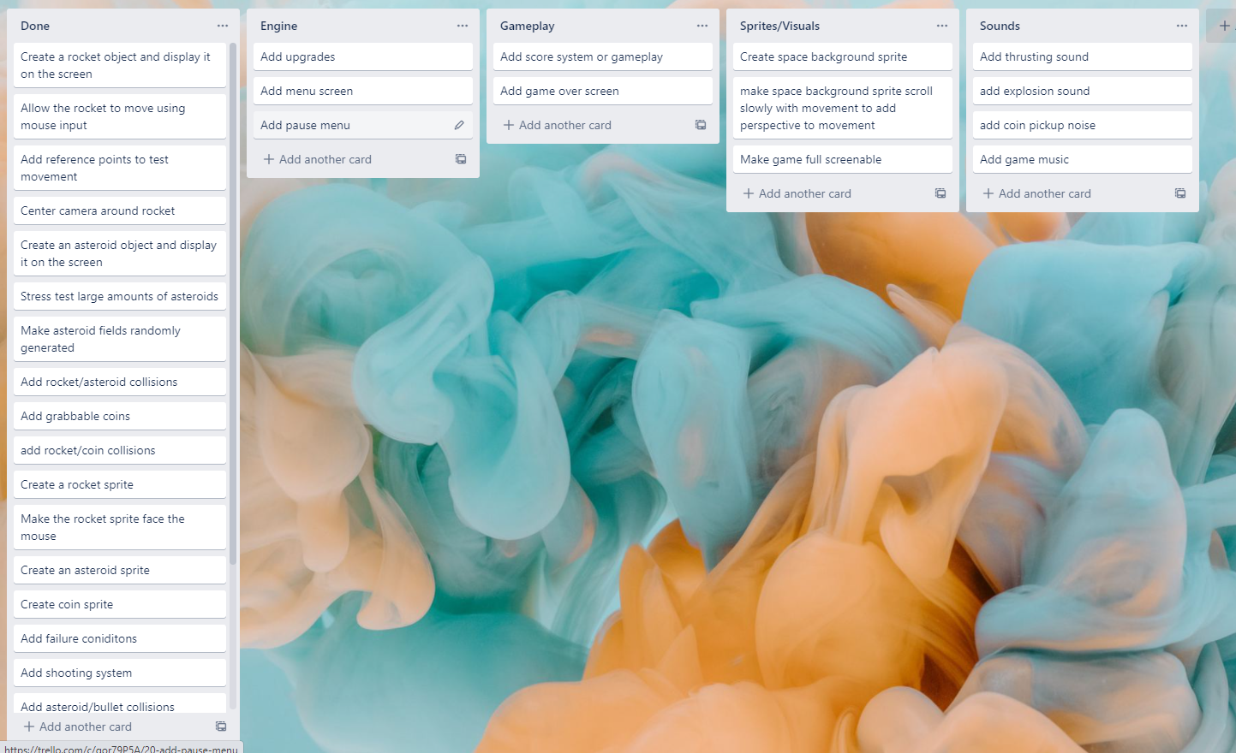
KANBAN Board at the start of the sprint

Slide 3
Sprint reflection and summary
I think I worked well during this sprint but I could have added more. The features I added will be important for the future more fleshed out version of the game, I have added asteroid types and a score system and basic game, this will be good for the future of the game so I am happy with this sprint.

Slide 4
Major changes and achievements
During this sprint I added actual asteroid types, A basic scoring system, and a basic game
In my last sprint I added the ability to have multiple types of asteroids in the game, during this sprint I implemented that by making coin and fuel asteroids, when you shoot a coin asteroid you get 1 coin, when you shoot a fuel asteroid your fuel is refilled to full. The asteroids both have their own respective sprites which are color shifted versions of the original sprite, I made them gold and green because I thought these would be the easiest for the user to understand what they were without a tutorial.
The scoring system and basic game I added is a timer of 120 seconds, the player has to go around and collect as many coins as possible (asteroids = 1 coin, grabbable coins = 5 coins), if the player hits an asteroid its game over, and the player has to go back to base to cash in their coins for points, so the player has to balance their time and speed to get enough coins but also not crash into an asteroid and have time to get back to the base.

Slide 5
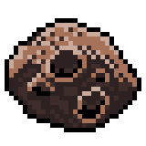
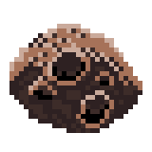
Brief description of your testing
While I was making my new asteroid textures I noticed that my asteroids all had a black background around them, you can’t tell in the game because the space background is also black, however since my game uses sprite based hitboxes it means that the hitboxes of the asteroids are bigger than they appear to be, I fixed this by erasing the black background from all of the asteroids sprites, than I tried flying close to asteroids with the new and old texture to see the collisions, with the new sprite the rocket would only explode when it was actually visibly touching the asteroid.

Slide 6
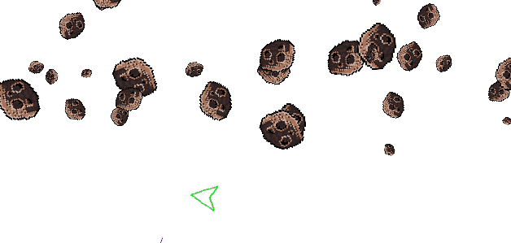
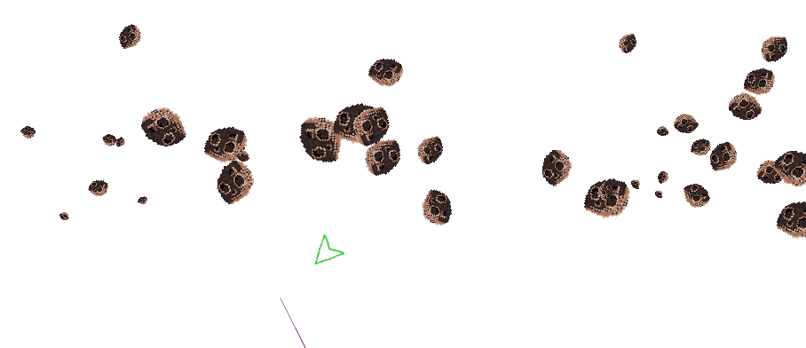
Link to testing/results table
Old hitboxes | New hitboxes

Slide 7
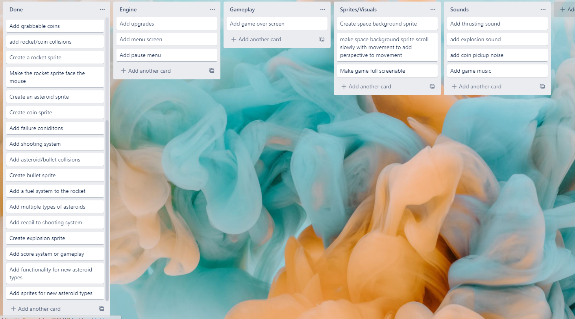
KANBAN Board at end of the sprint

Slide 8
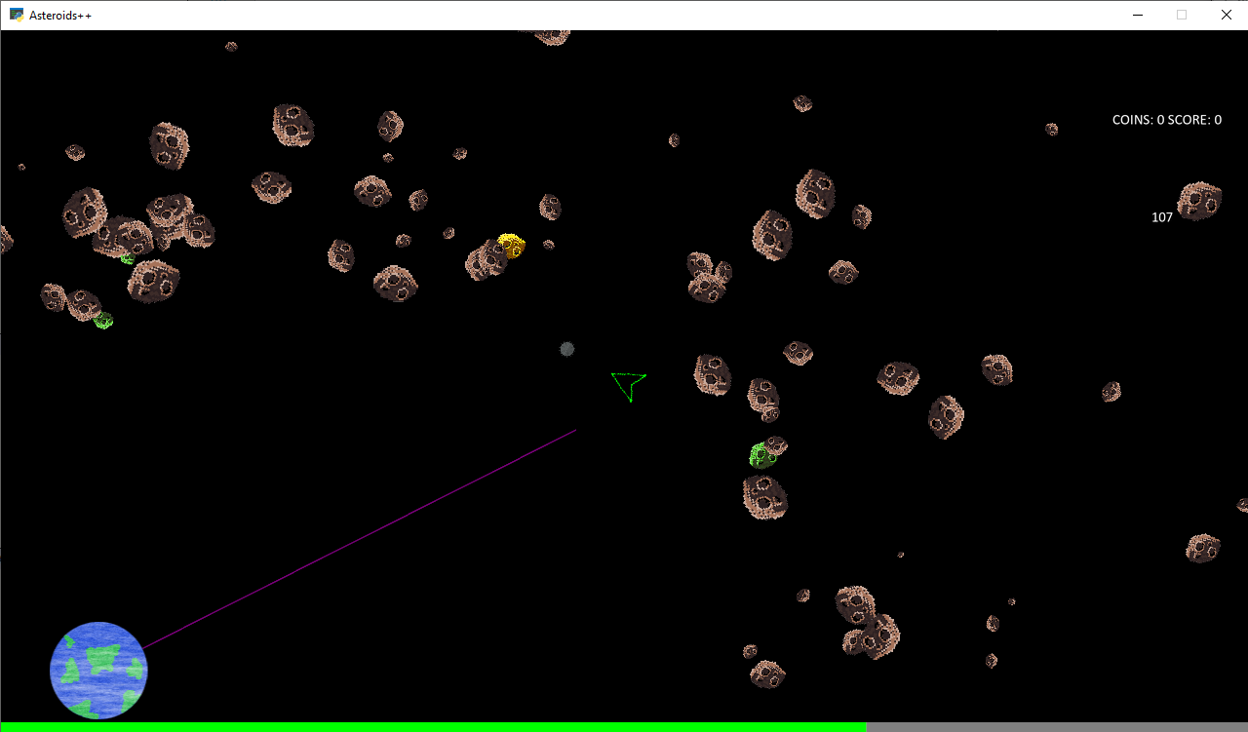
Screenshot of game at the end of the sprint

Slide 9
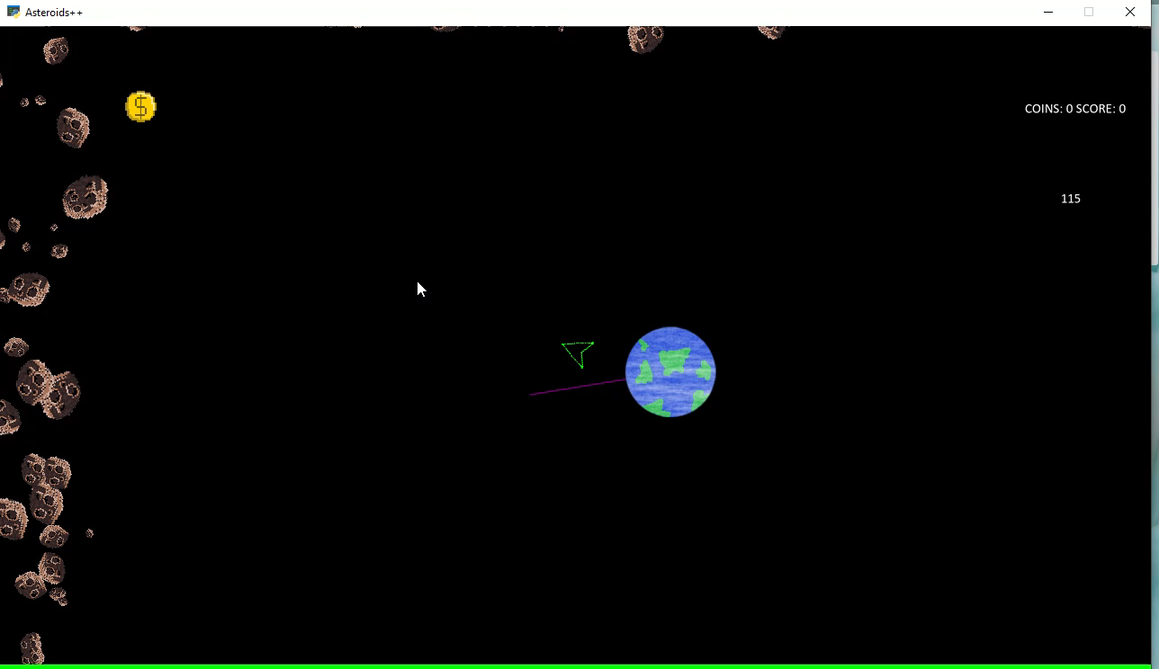
Video of the game at the end of the sprint

Slide 10
Notes for next time, future improvements
For my next sprint I would like to focus on the GUI of the game, I need to add a menu screen, a game over screen, work on the HUD, add a pause menu etc.

